Slide 1



Technology is not neutral?
Minjuan Luo ID:20313326 CSU11081

Slide 2
1
【Start with a single question】
2
【Real phenomenon in society 】
content
3
【Reference】
4
【Conclusion】

Slide 3


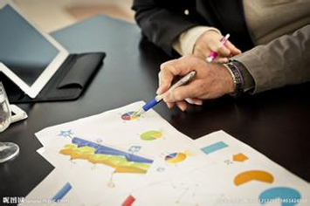
Start with a single question
the idea inside those codes because all those innovation are made by mankind
what if the designer himself brought all his opinion into the product he create?

Slide 4
Let's make an example
extreme atheist
designed a searching engine
change the algorithm
provide more atheistic thinking

Slide 5
Real phenomenon in society
phenomenon
positive result
negative result
White People
Black People

Slide 6
Reference
"Human wants to be lazy, so they created cars.
Human wants to be lazy, so they created washing machines.
Human wants to be lazy, so they created computers."
self-needs
in the subconscious
Issues which are left over from history
artificial intelligence

Slide 7
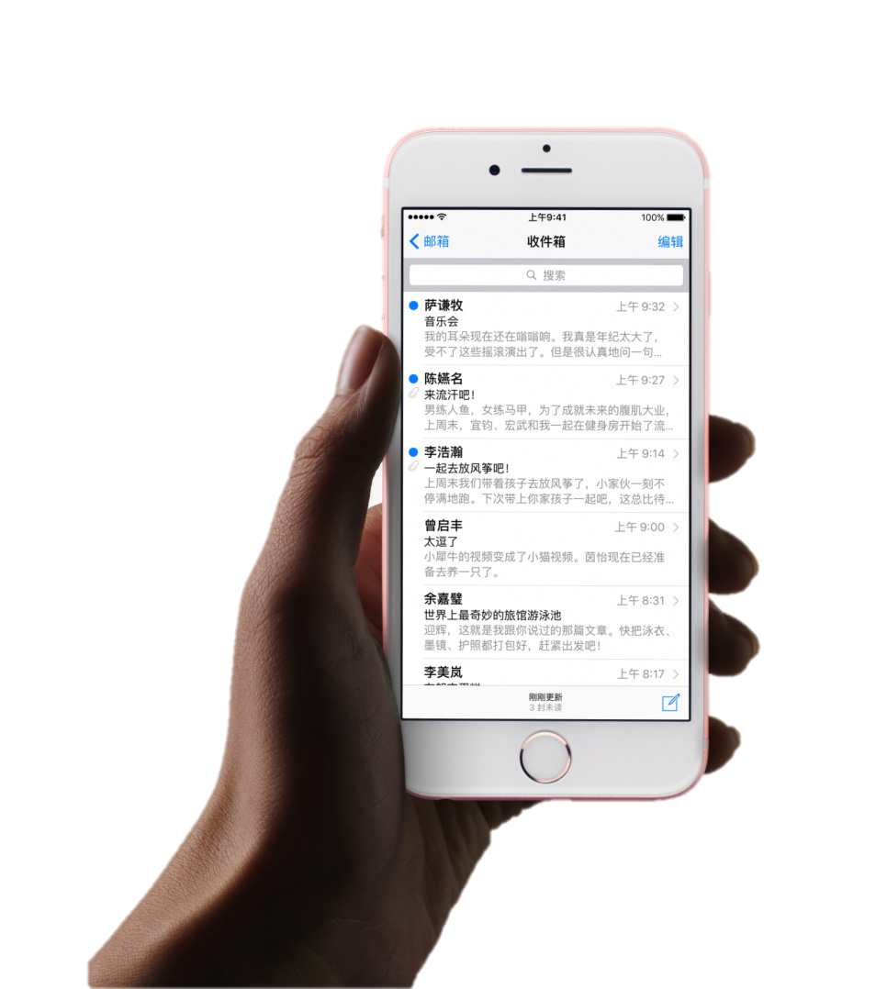
Conclusion
All in all
designer
human beings are to blame
technology is actually not neutral, because its designer-human beings themselves are to blame.
future
led by technology
“new things”
try to figure out whether there will be a optimal solution

Slide 8
The Limits of Mankind Will be Unlimited.
Minjuan Luo ID:20313326 CSU11081

